Slide 1


Today Class is about

Slide 2
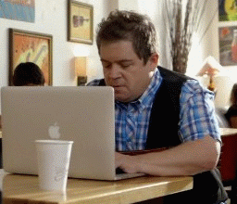
AD

Slide 3
Azure AD
Active Directory (AD) is a directory service developed by Microsoft that is used to manage and organize resources in a network environment.
It provides a centralized location for storing information about users, groups, computers, and other network objects.

Slide 4


Logical Topologies
Workgroup Model or Peer-To-Peer Model
Domain Model or Client/Server Model

Slide 5
Logical Topologies
IN A WORKGROUP MODEL
All computers are peers; no computer has control over another computer.
Each computer has a set of user accounts. To use any computer in the workgroup, you must have an account on that computer
IN A DOMAIN MODEL
One or more computers are servers. Network administrators use servers to control the security and permissions for all computers on the domain. This makes it easy to make changes because the changes are automatically made to all computers.

Slide 6
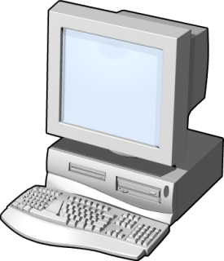
Workgroup Model
Computer3
Computer4
Windows 2000
user3
user4
Windows NT
Computer1
Computer2
Windows XP
user1
user2
Windows 2003

Slide 7
How Local Authentication works ?
Computer3
Computer4
Windows 2000
user3
user4
Windows NT
Computer1
Computer2
Windows XP
user1
user2
Windows 2003
User1

Slide 8
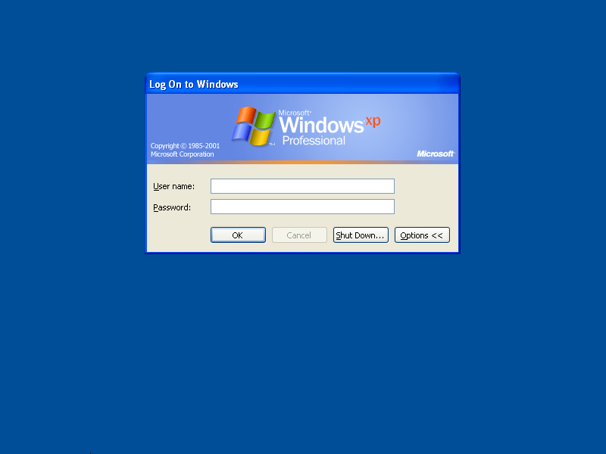
user1
****

Slide 9
How Local Authentication works ?
Computer3
Computer4
Windows 2000
user3
user4
Windows NT
user1 found
Authentication
Successful
Access - Granted
Computer1
LOCAL USER DATABASE
user1 | ****
Computer2
Windows XP
user1 | ****
Windows XP
user1
user2
Windows 2003
User1

Slide 10
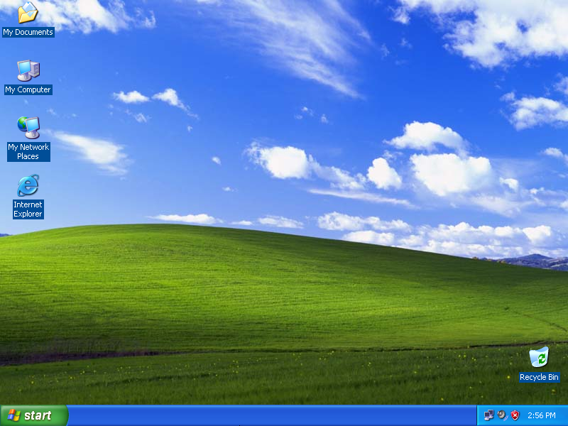

Slide 11
How Local Authentication works ?
Computer3
Computer4
Windows 2000
user3
user4
Windows NT
Computer1
Computer2
Windows XP
user1
user2
Windows 2003
User2

Slide 12
user2
****

Slide 13
How Local Authentication works ?
Computer3
Computer4
Windows 2000
user3
user4
Windows NT
user2 not found
Authentication
Fail
Access - Denied
Computer1
LOCAL USER DATABASE
user1 | ****
Computer2
Windows XP
Windows XP
user1
user2
Windows 2003
User2

Slide 15
How Local Authentication works ?
Computer3
Computer4
Windows 2000
user3
user4
Windows NT
Computer1
Computer2
Windows XP
user1
user2
Windows 2003
User2

Slide 16
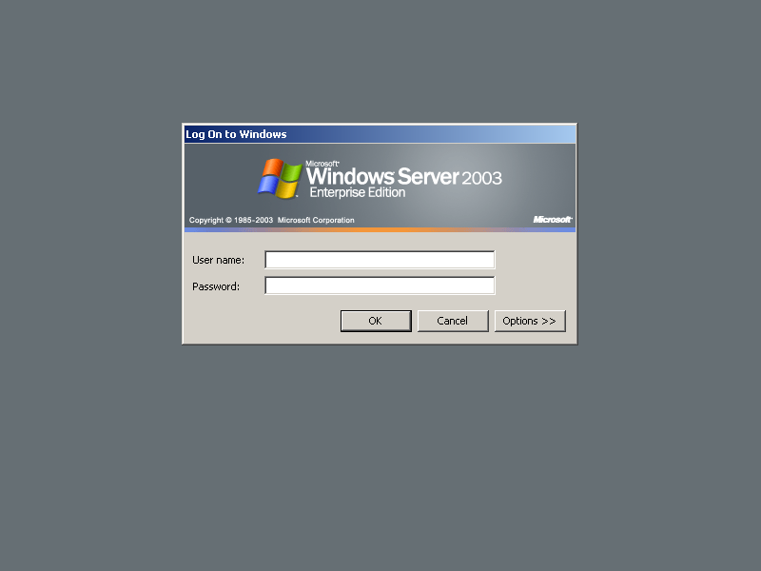
user2
****

Slide 17
How Local Authentication works ?
Computer3
Computer4
Windows 2000
user3
user4
Windows NT
user2 found
Authentication
Successful
Access - Granted
Computer1
LOCAL USER DATABASE
user2 | ****
Computer2
Windows XP
user2 | ****
user1
user2
Windows 2003
User2

Slide 18
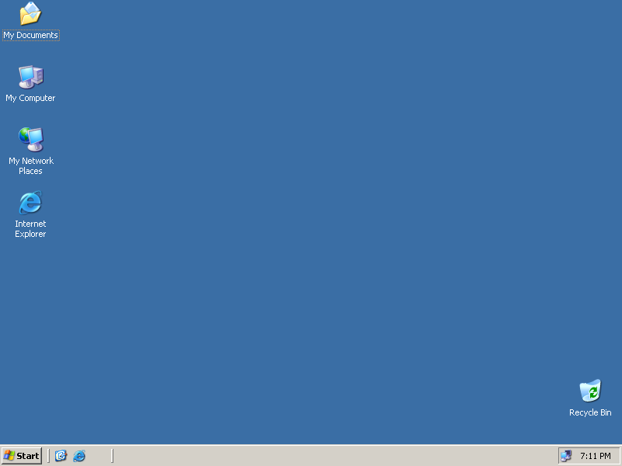

Slide 19
How Local Authentication works ?
Computer3
Computer4
Windows 2000
user3
user4
Windows NT
Computer1
Computer2
Windows XP
user1
user2
Windows 2003
User1

Slide 20
user1
****

Slide 21
How Local Authentication works ?
Computer3
Computer4
Windows 2000
user3
user4
Windows NT
user1 not found
Authentication
Fail
Access - Denied
Computer1
LOCAL USER DATABASE
user2 | ****
Computer2
Windows XP
user1
user2
Windows 2003
User2

Slide 23
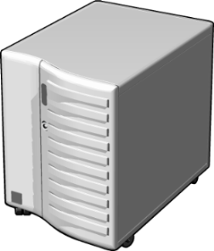
Domain Model
CENTRALIZED USER DATABASE
user1 | ****
user2 | ****
user3 | ****
NETRICH.COM
Windows 2012
Computer1
Computer2
Windows XP
Windows 8

Slide 24
How Centralized Authentication works ?
NETRICH.COM
Windows 2012
Computer1
Computer2
Windows XP
Windows 8

Slide 25
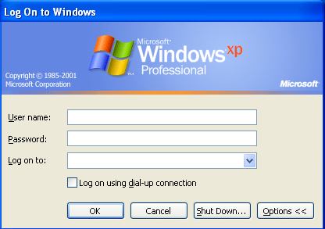
user1
****
NETRICH

Slide 26
How Centralized Authentication works ?
CENTRALIZED USER DATABASE
user1 | ****
user2 | ****
user3 | ****
user1 | ****
NETRICH
Windows 2012
Kerberos - Authentication
Successful
Access Granted
Computer1
Computer2
Windows XP
Kerberos - Authentication
Request
Windows 8

Slide 28
How Centralized Authentication works ?
NETRICH
Windows 2012
Computer1
Computer2
Windows XP
Windows 8

Slide 29
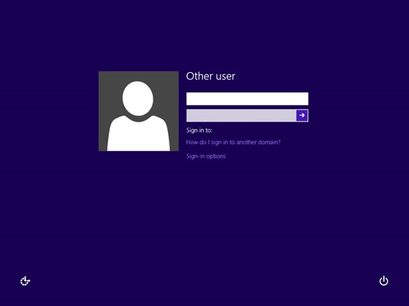
NETRICH\user1
****

Slide 30
How Centralized Authentication works ?
CENTRALIZED USER DATABASE
user1 | ****
user2 | ****
user3 | ****
user1 | ****
NETRICH
Windows 2012
Kerberos - Authentication
Successful
Access Granted
Computer1
Computer2
Windows XP
Kerberos - Authentication
Request
Windows 8

Slide 31
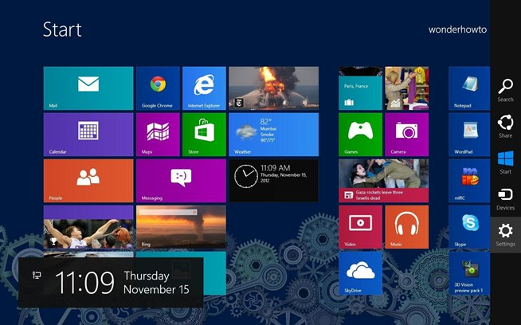

Slide 32
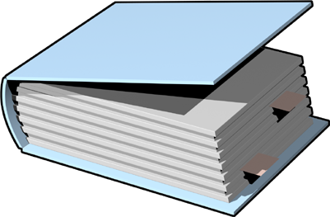
What Is Active Directory Domain Services ?
The AD DS database stores information on user identity, computers, groups, services and resources.
AD DS domain controllers also host the service that authenticates user and computer accounts when they log on to the domain
Active Directory DS

Slide 33

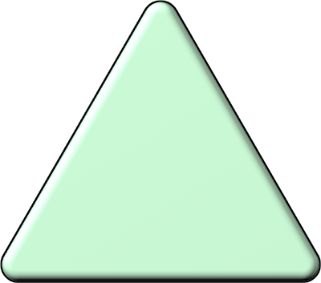

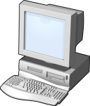
Domain
Domain is a logical grouping of user, computer, and group objects for the purpose of management and security.
Creating the initial domain controller in a network also creates the domain—you cannot have a domain without at least one domain controller.
Each domain is identified by a DNS domain name.
NETRICH.IN

Slide 34
Tree
MS.COM
(Parent Domain)
MCITP.MS.COM
(Child Domain)
MCTS.MCITP.MS.COM
(Grand Child Domain)

Slide 35
Tree
Tree is a set of one or more domains with contiguous names.
If more than one domain exists, you can combine the multiple domains into hierarchical tree structures.
The first domain created is the root domain of the first tree.
Other domains in the same domain tree are child domains.
A domain immediately above another domain in the same domain tree is its parent.

Slide 36
Forest
FOREST
MS.COM
SOFT.COM
(Forest/Tree Root)
(Tree Root)
TREE
TREE
MCITP.MS.COM
(Child Domain)

Slide 37
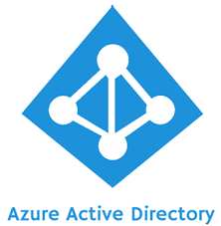
Azure AD
Azure Active Directory (Azure AD) is a cloud-based identity and access management service provided by Microsoft.

Slide 38
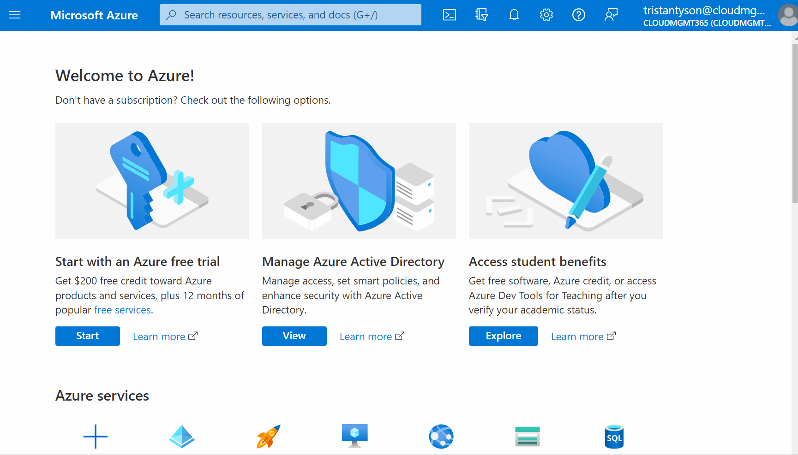
Custom Domain

Slide 39
Custom Domain
A custom domain refers to the ability to use your organization's own domain name for user sign-ins and to represent your organization's brand in Azure AD services.
Record Type | Purpose | Usage in Azure AD Domain Configuration
TXT | Used to store arbitrary text data in DNS records | Required for domain verification in Azure AD
 |  | Demonstrates ownership of the domain
 |  | Contains a verification code or token provided by Azure AD
MX | Specifies the mail server responsible for email | Not directly related to domain verification in Azure AD
 | routing | Used for email routing to specific mail servers
 |  | Points to the domain name of the mail server

Slide 40
Azure AD
Users
Crete User
Invite User
Cloud Access (Azure VM)
Roles
Groups
On Premises Machines Access
AD Register
AD Join
Single sign on
Bulk User
MFA (Multi Factor Authentication)

Slide 41
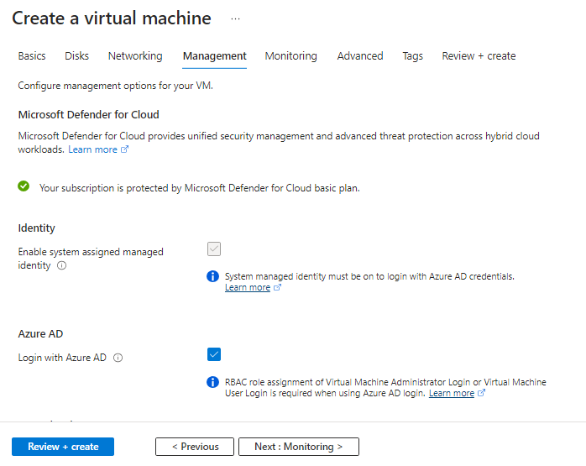
Cloud Access (Azure VM) - with AZAD

Slide 42
Cloud Access (Azure VM) – Role Assignment
For Resource Group, select the resource group that contains the VM and its associated virtual network, network interface, public IP address, or load balancer resource.
Select Access control (IAM).
Select Add > Add role assignment to open the Add role assignment page.
Assign the following role.
Setting | Value
Role | Virtual Machine Administrator Login or Virtual Machine User Login
Assign access to | User, group, service principal, or managed identity
Note : Virtual Machine Contributor

Slide 43
Cloud Access (Azure VM) – Disable NLA
Run Command
Disable NLA
Run Script
Note: Disabling Network Level Authentication (NLA) reduces the security of your Azure Virtual Machine (VM) because NLA provides an additional layer of security by requiring authentication before establishing a Remote Desktop Protocol (RDP) connection to the VM.
Modify RDP
enablecredsspsupport:i:0
authentication level:i:2

Slide 44
Login
Username : azuread\<userid>
Password : <Password>
But before login in the portal with this user changing the password is Mandatory

Slide 45
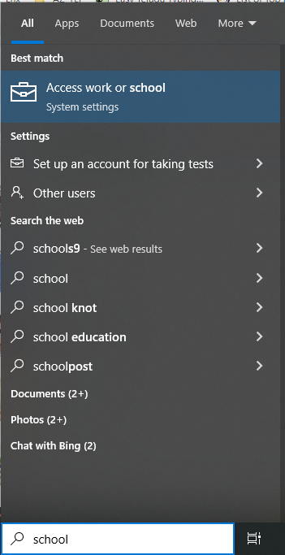
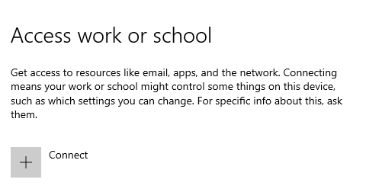
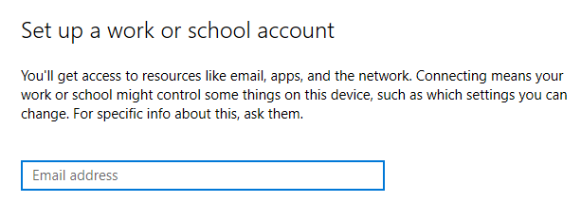
On Premises Machines Access – Ad Register

Slide 46
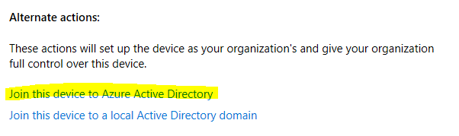
On Premises Machines Access – Ad Join

Slide 47
AD Connect
Azure AD Connect is a Microsoft tool that enables synchronization and integration between on-premises Active Directory (AD) and Azure Active Directory (Azure AD). It allows organizations to extend their existing AD infrastructure to the cloud and enable various hybrid identity scenarios.

Slide 48
Project 4

